Slide 1
Module – 2 Engineering Ethics & Professionalism

Slide 2
Topics
Senses of Engineering Ethics
Variety of moral issues
Types of inquiry
Moral dilemmas
Moral Autonomy
Kohlberg’s theory- Gilligan’s theory-
Consensus and Controversy-Profession and Professionalism-
Models of professional roles-
Theories about right action –Self interest
Customs and Religion
Uses of Ethical Theories.

Slide 3
Professional Ethics
Professional ethics is a set of ethical standards and values a practicing engineer is required to follow.
It sets the standards for professional practice
Today, it is an essential part of professional education because it helps students deal with issues they will face.

Slide 4
SENSES OF ENGINEERING ETHICS
Engineering ethics has also various senses which are related to one another.
2 different senses (meanings) of engineering ethics
A.) Normative senses
B.) Descriptive senses

Slide 5
Normative sense includes:
Knowing moral values, finding accurate solutions to moral problems and justifying moral judgments in engineering practices,
Study of decisions, policies, and values that are morally desirable in the engineering practice and research, and
Using codes of ethics and standards and applying them in their transactions by engineers.

Slide 6
Descriptive senses includes:
The descriptive sense refers to what specific individual or group of engineers believe an act, without justifying their beliefs or actions.

Slide 7
Ethics v/s Engineering Ethics
Ethics | Engineering Ethics
Ethics is making investigations and knowing about moral values | Engineering ethics aims at knowing moral values related to engineering
Total view on moral issues | How to solve moral issues related to engineering field.
Ethics is used a means of describing the beliefs, attitudes etc., | Codes and standards which are to be followed by group of engineers

Slide 8
VARIETY OF MORAL ISSUES
According to the Oxford dictionary, morality means principles concerning right and wrong or good and bad behavior.
The word morality is concerned with:
1.) What morally ought or ought not to be given in a situation
2.) What is morally right or wrong in handling a situation
3.) What is morally good or bad about the people, policies, and ideals involved in it?

Slide 9
TYPES OF INQUIRY
Inquiry means an investigation.
Engineering ethics also involves investigations into values, meaning and facts.
Inquiries in the field of Engineering ethics are of three types.
1.) Normative Inquiries
2.) Conceptual Inquiries
3.) Factual or Descriptive Inquiries

Slide 10
Normative Inquiries
These inquiries are mostly helpful to identify the values which guide the individuals and groups in taking a decision
Identifying and justifying some norms and standards of morally desirable nature for guiding individuals as well as groups.

Slide 11
Conceptual Inquiries
These are meant for describing the meaning of concepts, principles, and issues related to Engineering Ethics
Factual / Descriptive Inquiries
These help to provide fact for understanding and finding solutions to value based issues.

Slide 12
MORAL DILEMMAS
Moral dilemmas are situations in which two or more moral obligations, duties, rights, goods, or ideals come into conflict with each other
These situations do not mean that things had gone wrong, but they only indicate the presence of moral complexity.
This makes the decision making complex.
For example, a person promised to meet a friend and dine, but he has to help his uncle who is involved in an accident one has to fix the priority.

Slide 13
Causes of Moral Dilemmas
Problem of vagueness
Problem of conflicting reasons
Problem of disagreement.

Slide 14
Steps / Procedures in facing moral dilemma
Identifying the relevant moral factors and reasons
Collecting all the available facts which are relevant to the moral factors
Ranking the moral considerations or principles on the basis of importance as applicable to the situation
Considering alternative courses of action for resolving the problems
Suggestions and alternative ideas on resolving that dilemma from colleagues, friend etc.,
Arriving at solution by taking into consideration of all important moral factors

Slide 15
MORAL AUTONOMY
Moral Autonomy is the philosophy which is self-governing or self-determining
The moral autonomy is the ability to think critically and independently about moral issues and apply this moral thinking to situations that arise during the professional engineering practice.
Moral autonomy helps in improving self-determination.

Slide 16
Skills required for Moral Autonomy
Ability to relate the problems with the problems of law, economics and religious principles
Skill to process, clarify and understand the arguments against the moral issues
Ability to suggest the solutions to moral issues
Must have the imaginative skill to view the problems from all the viewpoints
Tolerance while giving moral judgment

Slide 17
CONSENSUS AND CONTROVERSY
CONSENSUS
This is that state where people come into agreement with the judgment given and will leave the people with a feel that justice has been done
CONTROVERSY
This is that state where the persons involved in an issue are not satisfied by the verdict and might feel that it was decided on partial interests.
This will leave the people with a sense of dissatisfaction that justice was not done, which might lead to another conflict.

Slide 18
Moral Development Theories
KOHLBERG’S THEORY
Lawrence Kohlberg proposed that people progress in moral reasoning based on their ethical behavior.
He postulated this theory based on the thinking of younger children throughout their growing period as adults.
He conveyed that younger children make judgment based on the consequences that might occur and the older children make judgment based on their intuitions.

Slide 19
3 Stages of Kohlberg’s Theory
1. Pre-conventional Level
The first level of moral thinking, which is generally found at Elementary school level. The thinker at this stage tends to think and behave based on the direct consequences that might occur
There are two sub-stages in this.
a. Avoid Punishments
b. Self–interest

Slide 20
2. Conventional Level
The second level of moral thinking, which is generally found at the primary and high school level. The thinker at this stage tends to think and behave based on the want to please others.
There are two sub-stages in this.
a. Getting people to like them
b. Maintain functioning in society

Slide 21
3. Post-Conventional Level
The third level of Moral thinking, which is generally found after the high school level. The thinker at this stage tends to think and behave based on a sense of justice.
There are two sub-stages in this
Reject rigidity of laws
Sense of justice

Slide 22
Gilligan’s Theory
Carol Gilligan opines that Kohlberg’s theories are biased upon the male thinking process.
Men had a tendency to solve problems by applying ethical principles .
She proposed a theory which has the same three stages of Kohlberg but with different stages of moral development.

Slide 23
Stages of theory
Pre-conventional Level
A person in this stage cares for oneself to ensure survival.
Conventional Level In this stage, the person feels responsible and shows care towards other people.
Post-conventional Level
This is the stage, where the principle of care for self as well as others, is accepted.

Slide 24
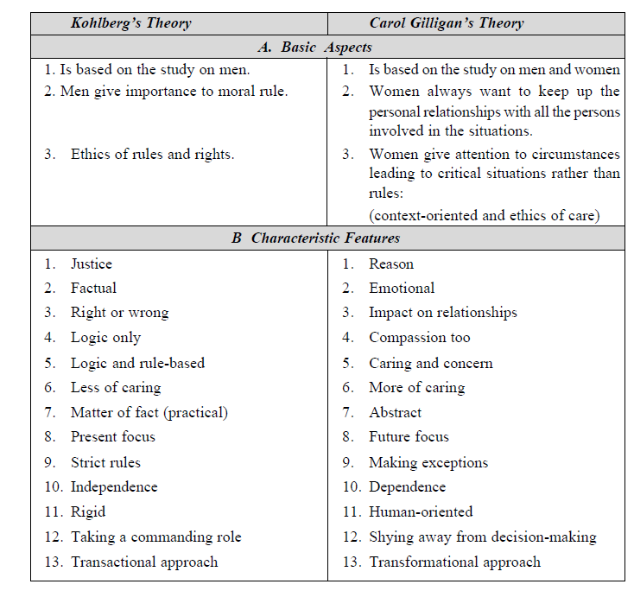

Slide 25
PROFESSION AND PROFESSIONALISM
Profession
Profession means a job or an occupation, that helps a person earn his living. The main criteria of a profession involves the following.
Advanced expertise
Self-regulation
Public good
Professional
A person who is paid for getting involved in a particular profession in order to earn a living as well as to satisfy the laws of that profession

Slide 26
Professionalism
The art of Professionalism can be understood as the practice of doing the right thing, not because how one feels but regardless of how one feels
Professionalism covers comprehensively all areas of practice of a particular profession.
It requires skills and responsibilities involved in engineering profession.
Professionalism implies a certain set of attitudes

Slide 27
MODELS OF PROFESSIONAL ROLES (PROFESSIONAL ROLES TO BE PLAYED BY AN ENGINEER)
Engineers as Saviors
Engineers as Guardians
Engineers as Bureaucratic Servants
Engineers as Social Servants
Engineers as Social Enablers and Catalysts
Engineers as Game Players

Slide 28
THEORIES ABOUT RIGHT ACTION (Ethical Theories)
Types of Ethical Theories:
Depending upon the ethics a person is intended to follow, four theories were postulated by four different philosophers
1. Golden Mean Ethics
2. Duty Based Ethics
3. Right Based Ethics
4. Utilitarian Ethics

Slide 29
The Golden Mean ethical theory
This theory was proposed by Aristotle
According to this theory, the solution to a problem is found by analyzing the reason and the logic
What is Golden Mean?
The Golden Mean virtue can be understood as the virtue of reaching a proper balance between extremes in conduct, emotion, desire and attitude
This theory phrased by Aristotle states that virtues are tendencies to find the golden mean between the extremes of too much (excess) and too little (deficiency) with regard to particular aspects of our lives.

Slide 30
Rights-based Ethical Theory
This theory was proposed by John Locke.
According to this theory, the solution to a problem is by realizing that every person has a right to live.
Live and let live is the philosophy behind this theory. The rights of a person towards life, health, liberty, possession, etc. are taken care of under this theory.

Slide 31
Duty-based Ethical Theory
The duty-based ethical theory was proposed by Immanuel Kant.
According to this theory, every person has a duty to follow which is accepted universally, with no exceptions.
Kant observed that everyone is bound to follow some moral laws.
There are four virtues that come under this law
Prudence > Every individual has duties which should be done without any exception.
Temperance > The temptations that might lead to the violation of duties and ethics have to be restrained
Fortitude > Sense of having tolerance
Justice > Truth and fairness

Slide 32
Utilitarian Ethics
The Utilitarian ethics was proposed by John Stuart.
According to this theory, the happiness or pleasure of a greatest number of people in the society is considered as the greatest good.
There are two main types of Utilitarianism. They are −
Act Utilitarianism > “A particular action is right if it is likely to produce the higher level of good for the most people in a given situation, compared to alternative choices that might be made.”
2. Rule Utilitarianism > “Right actions are those required by rules that produce the higher level of good for the most people.”

Slide 33
SELF-INTEREST
Self-interest is nothing but one’s personal good.
It refers to the goodness of oneself in the long run.
Morality essentially needs a willingness on the part of both individuals and corporations to place some restrictions on the pursuit of private self – interests.

Slide 34
CUSTOMS AND RELIGION
When we talk about customs and religion
They are related historically
Trust gives an inspiration to be moral.
Motivating right action based on ethical principles
Helps us to set a higher moral standards

Slide 35
USES OF ETHICAL THEORIES
Identifying the moral considerations or reasons that constitute a dilemma.
Provides a precise sense of information
Rank the relevant moral considerations
Helps to reach balanced and insightful judgments

